Slide 1
Adding pilot points to an existing zone/PEST model via Groundwater Vistas – GW1876 February 2020
You have a model in GWV7 like where we ended up after importing – zone based model hooked up to PEST. Here is a workflow for adding a pilot point grid to the Freyberg 2.0 model.
Here is a walk through of all the steps that we did in class.
The directory the base model is: ..\activities_stpete\base_model_files\vistas_holding
1) Open the GWV file created from our import

Slide 2
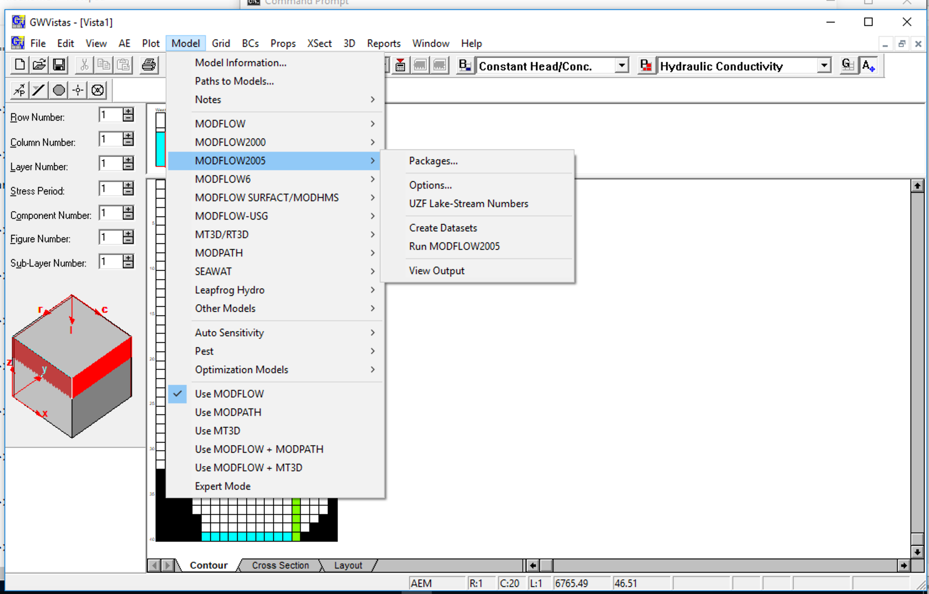
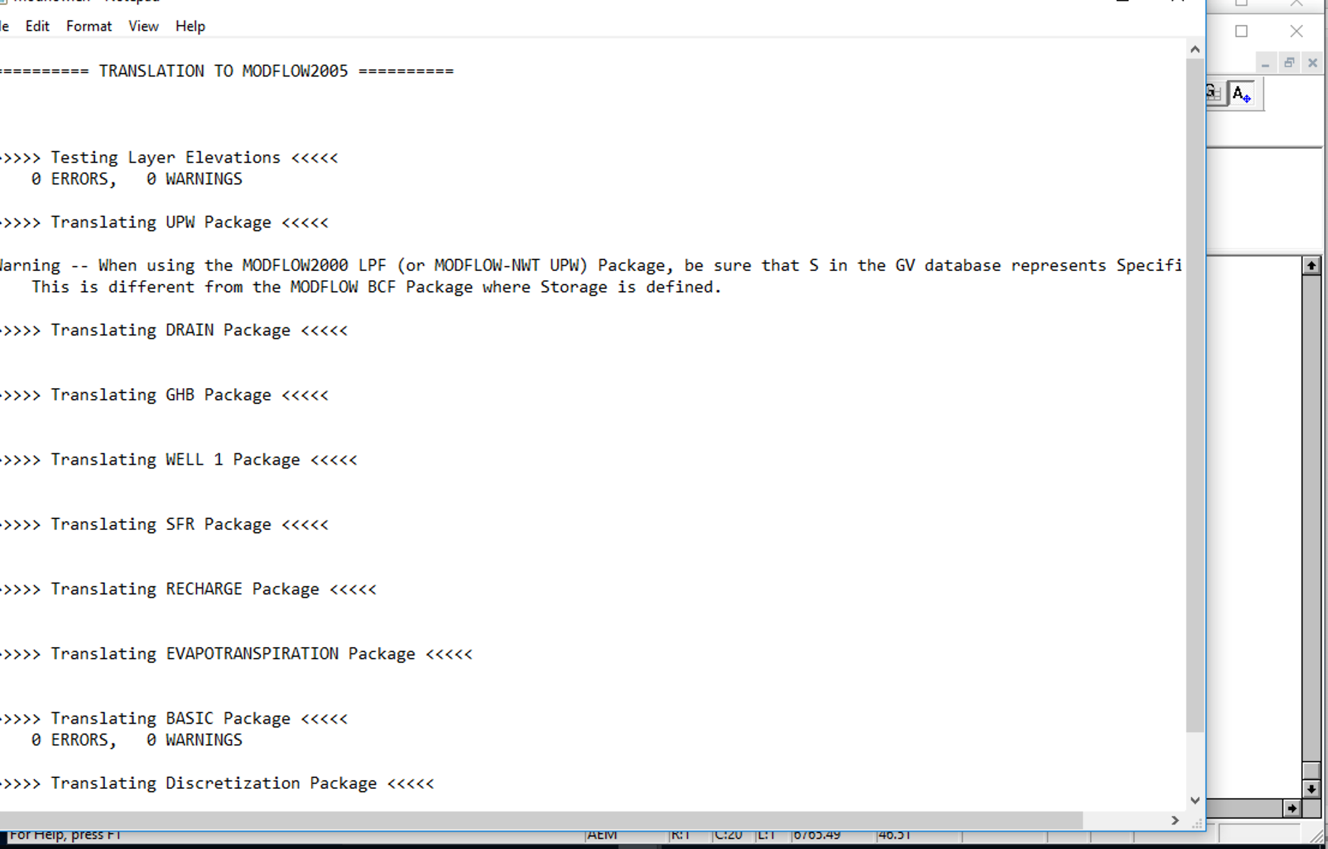
2) Create datasets/Run to have MODFLOW files to translate to PEST
1

Slide 3
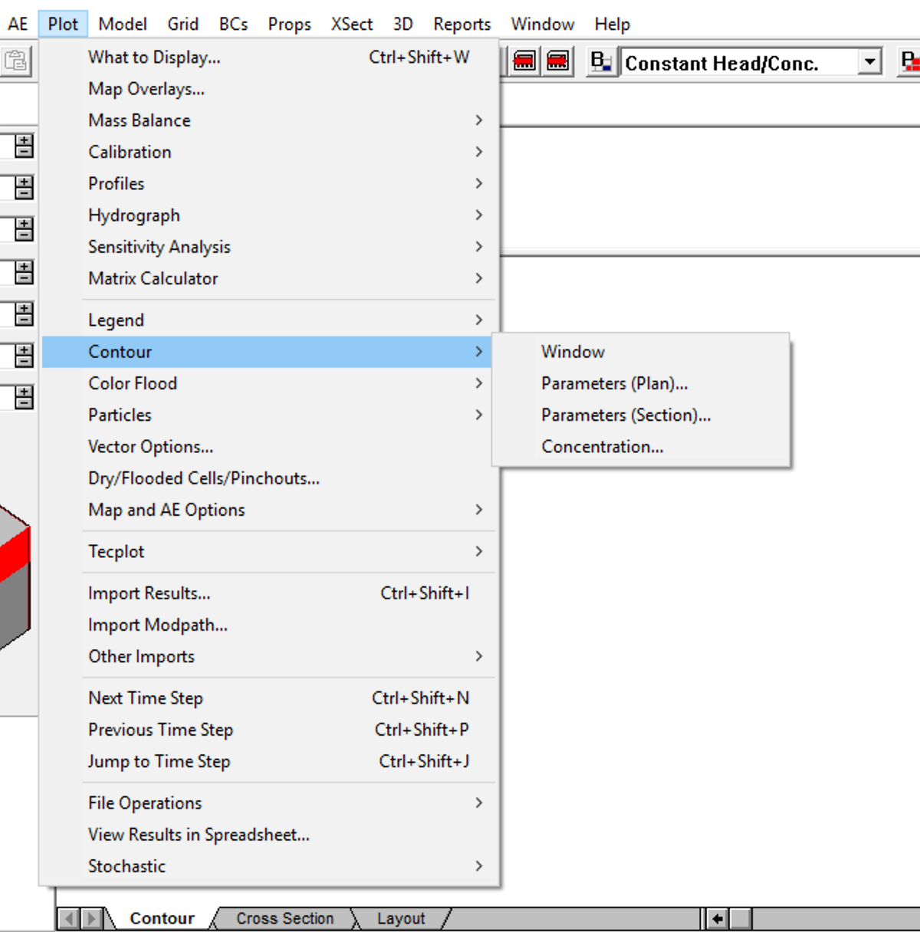
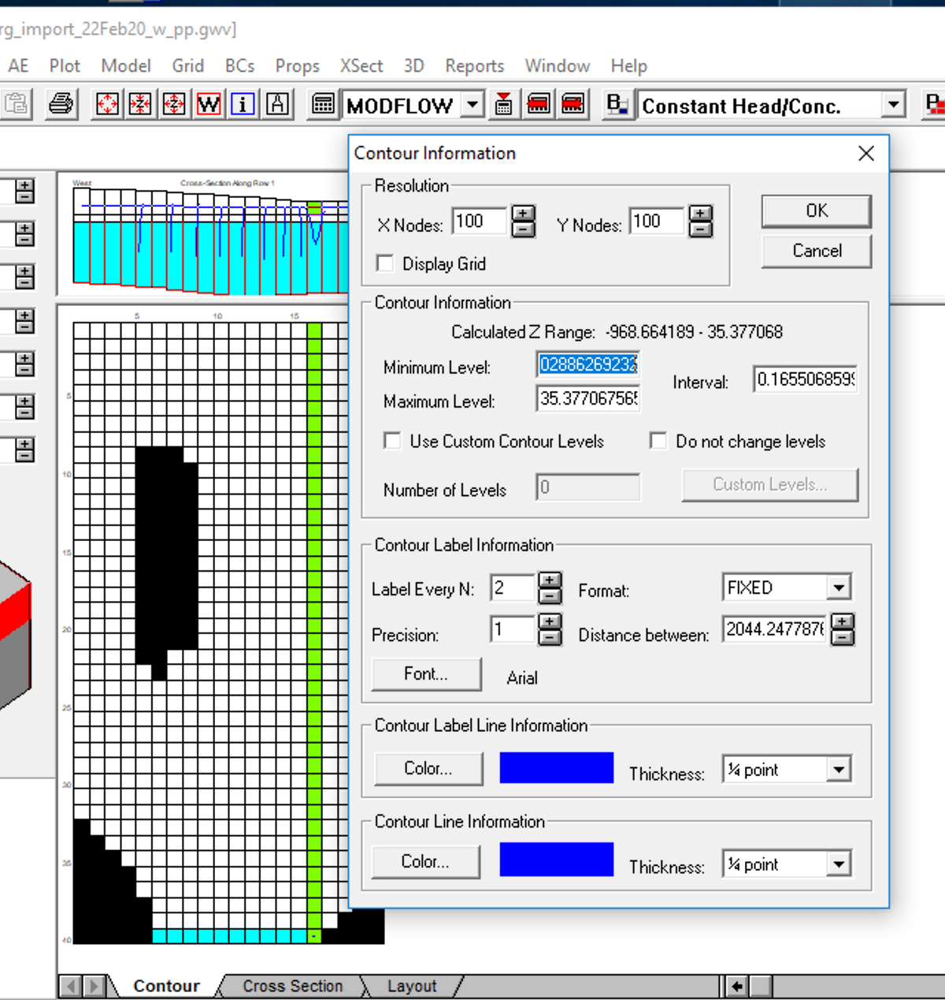
3) Reset contour span for odd SFR cell in row 40 to see contours in layer 1
Set to 30

Slide 4
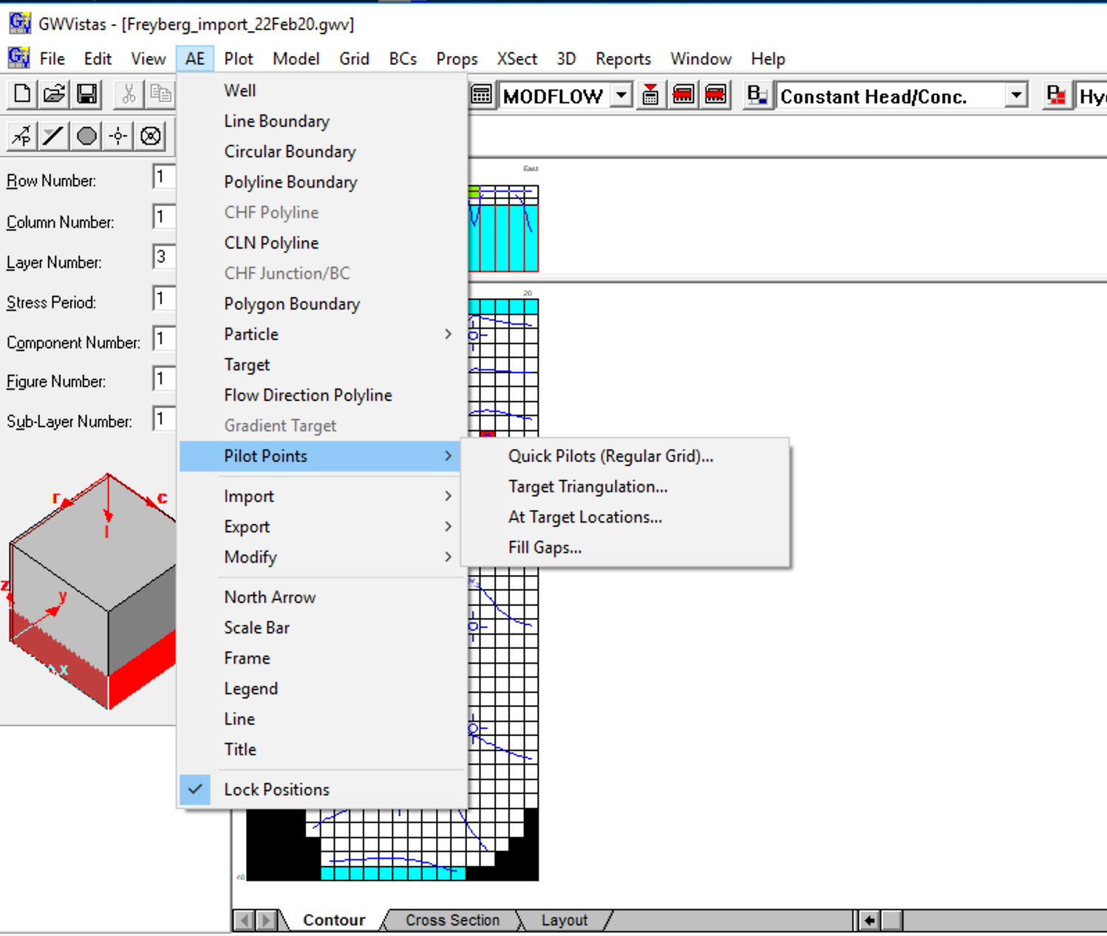
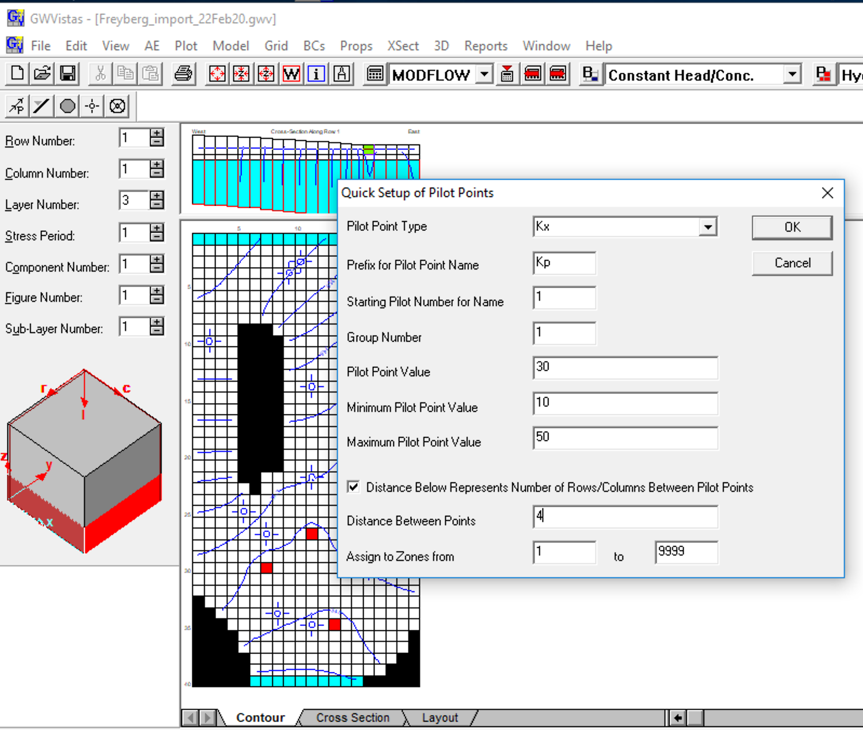
4) Move down to layer 3 (where the observations are) and add pilot points

Slide 5
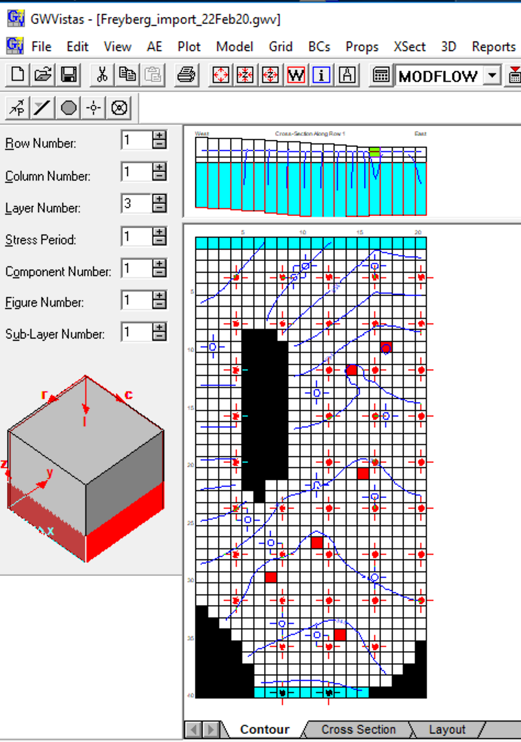
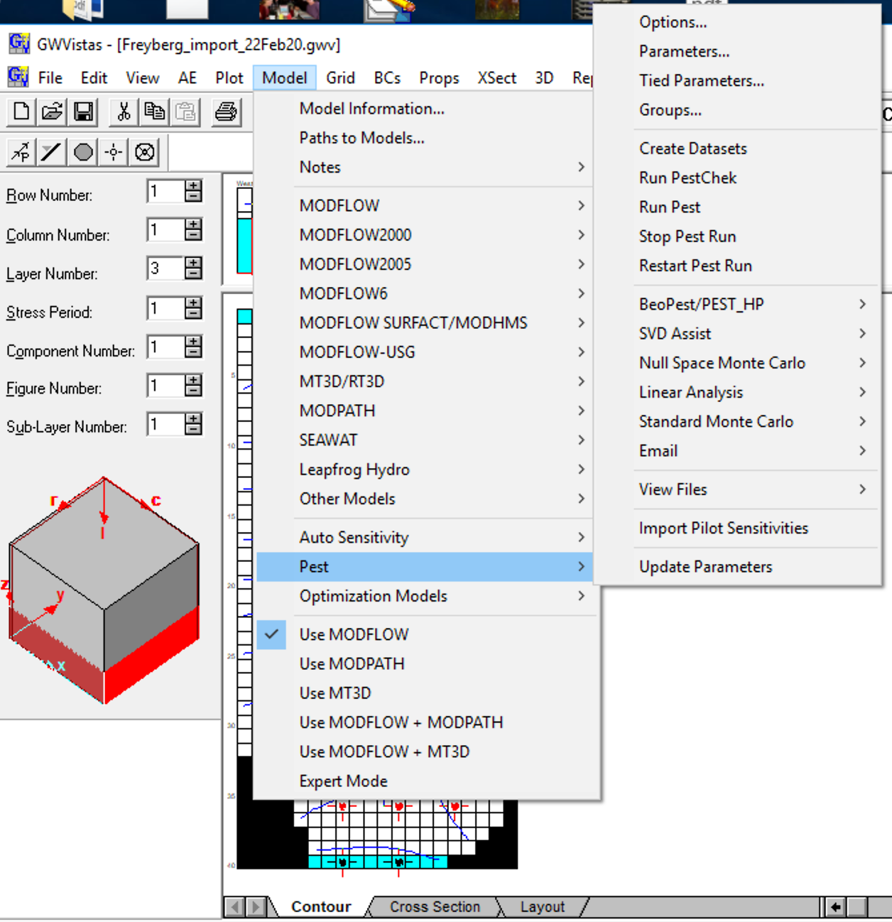
5) Go to Model->PEST->Options
Resulting display – note pilot points every 4 nodes

Slide 6
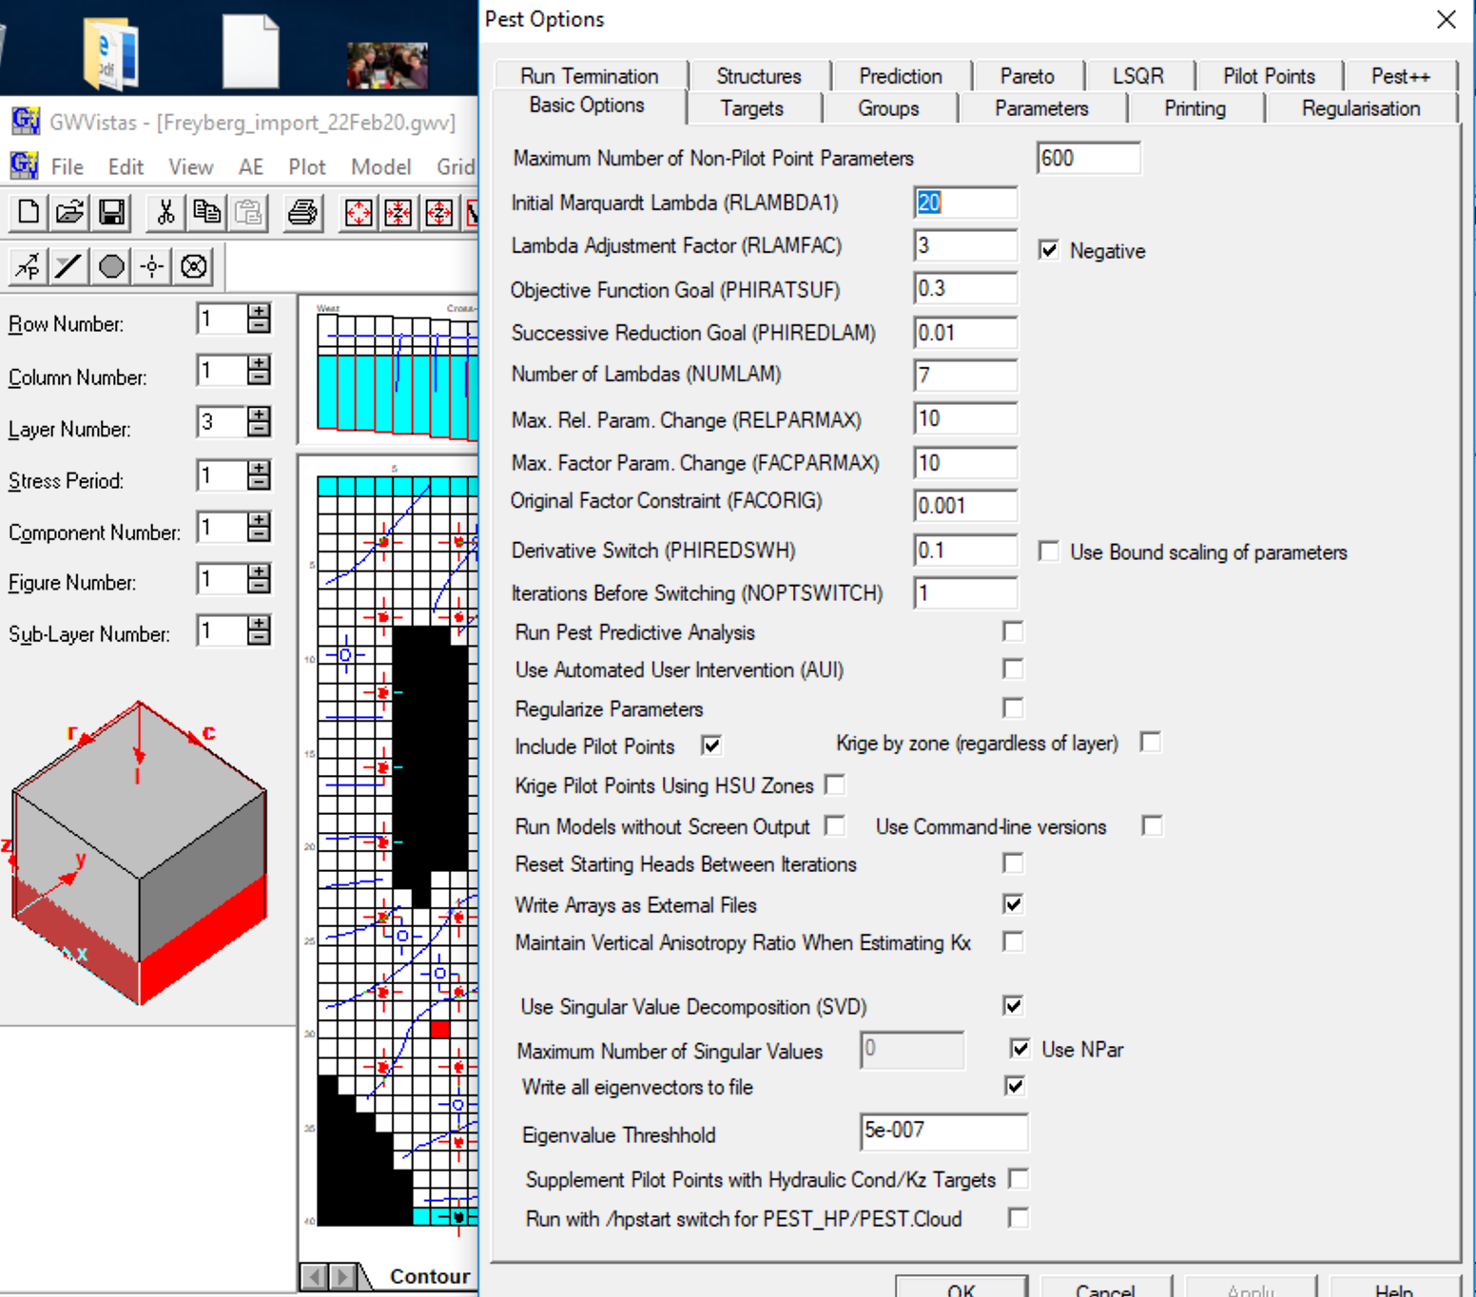
6) Choose include pilot points and use external arrays. (Model->PEST->Options->Basic Options)

Slide 7
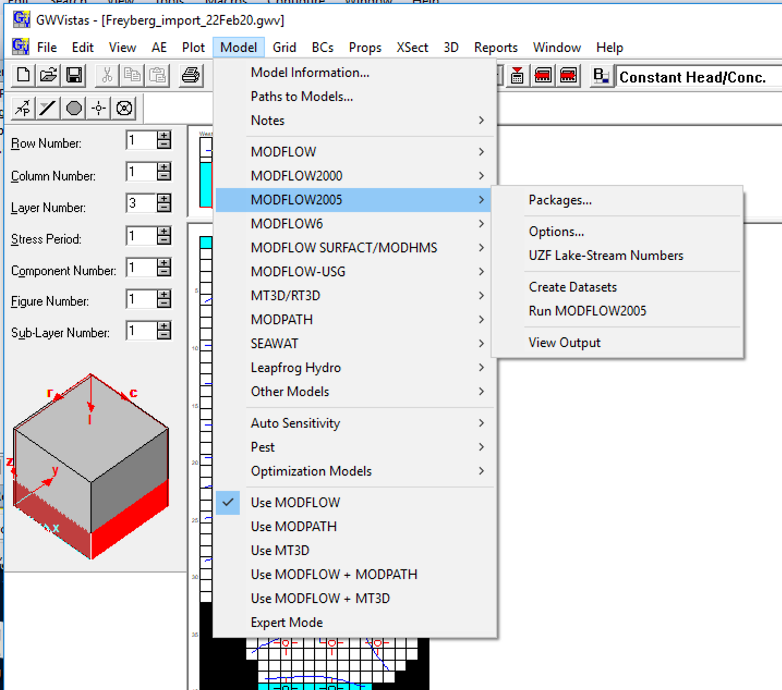
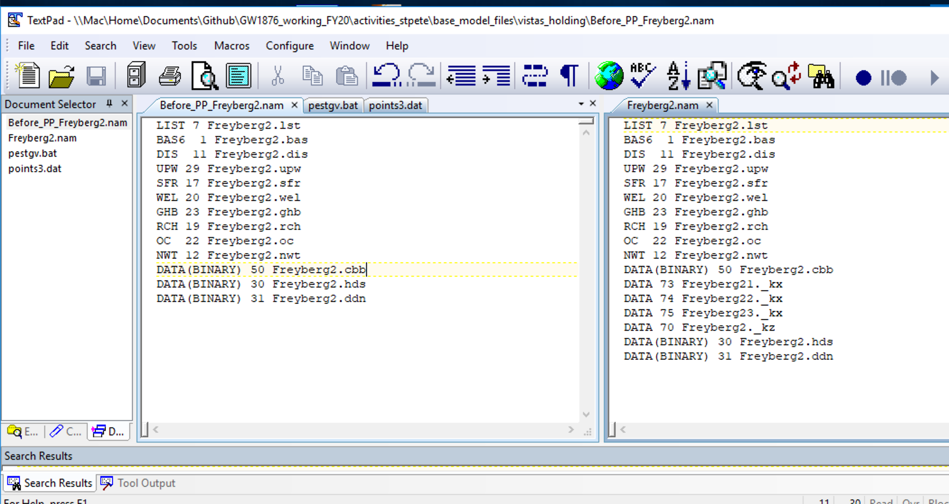
6) IMPORTANT - Recreate MODFLOW files – check nam file for new external arrays
Non pilot point nam file
Pilot point nam file

Slide 8
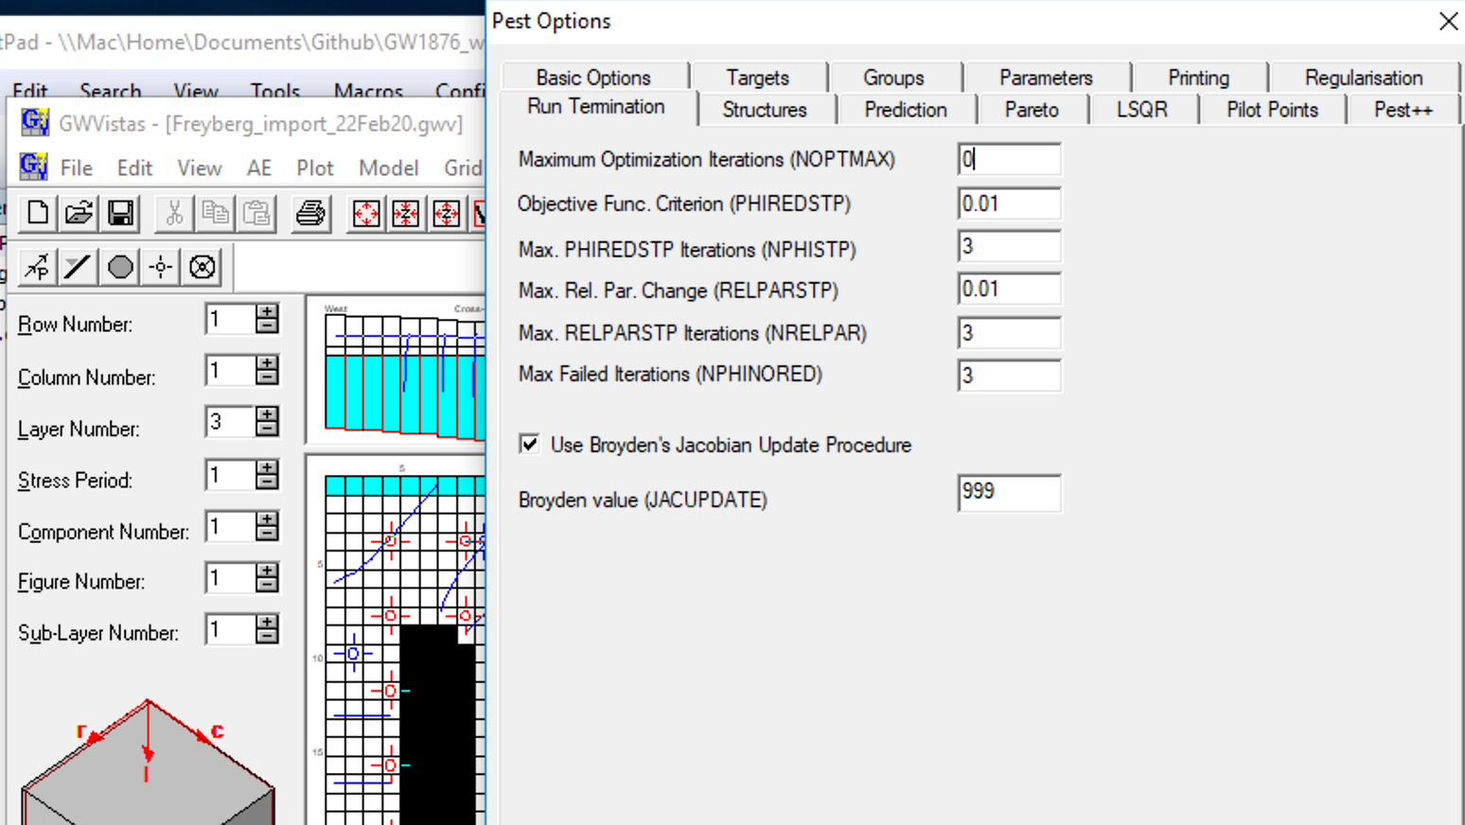
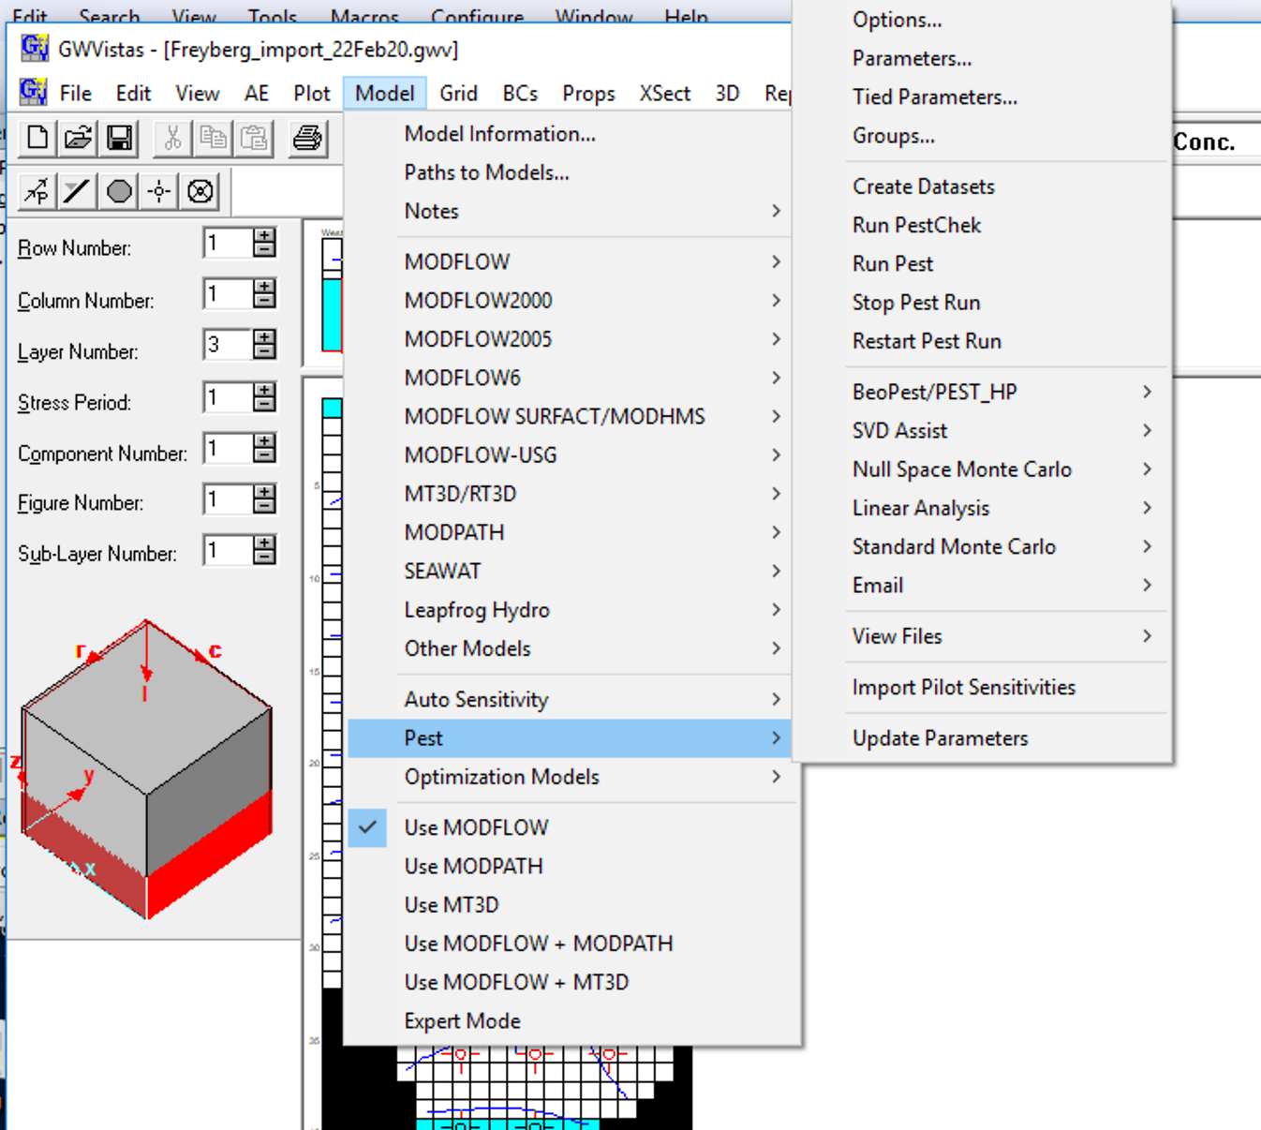
7) Change NOPTMAX to 0 to check plumbing
8) Create PEST dataset

Slide 9
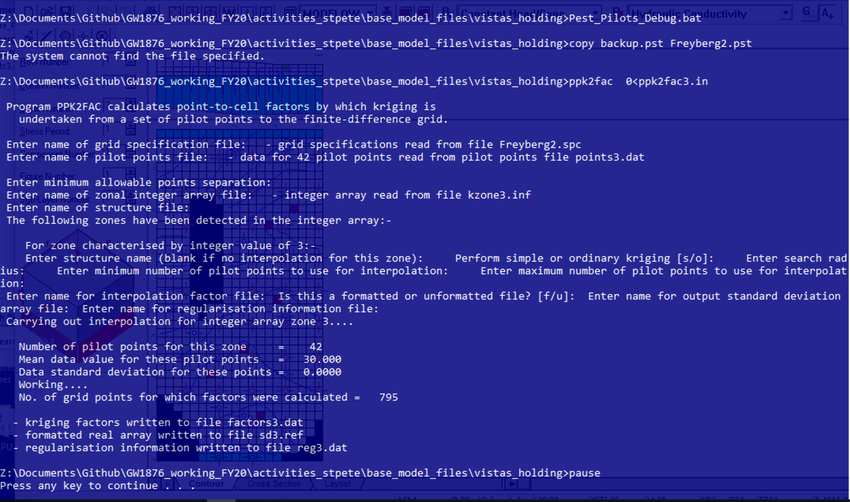
9) In DOS box step through the screens that flashed by running PEST_Pilots_Debug.pst

Slide 10
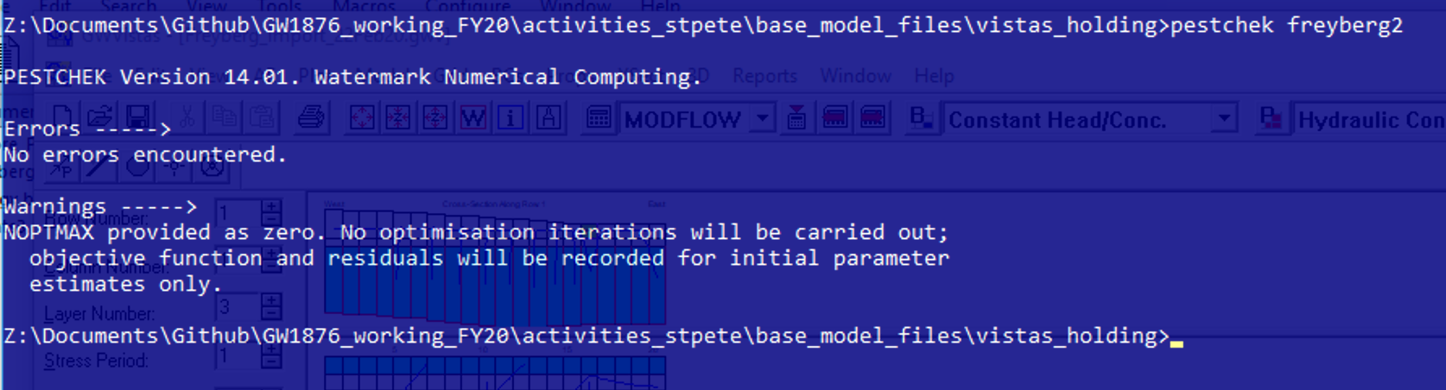
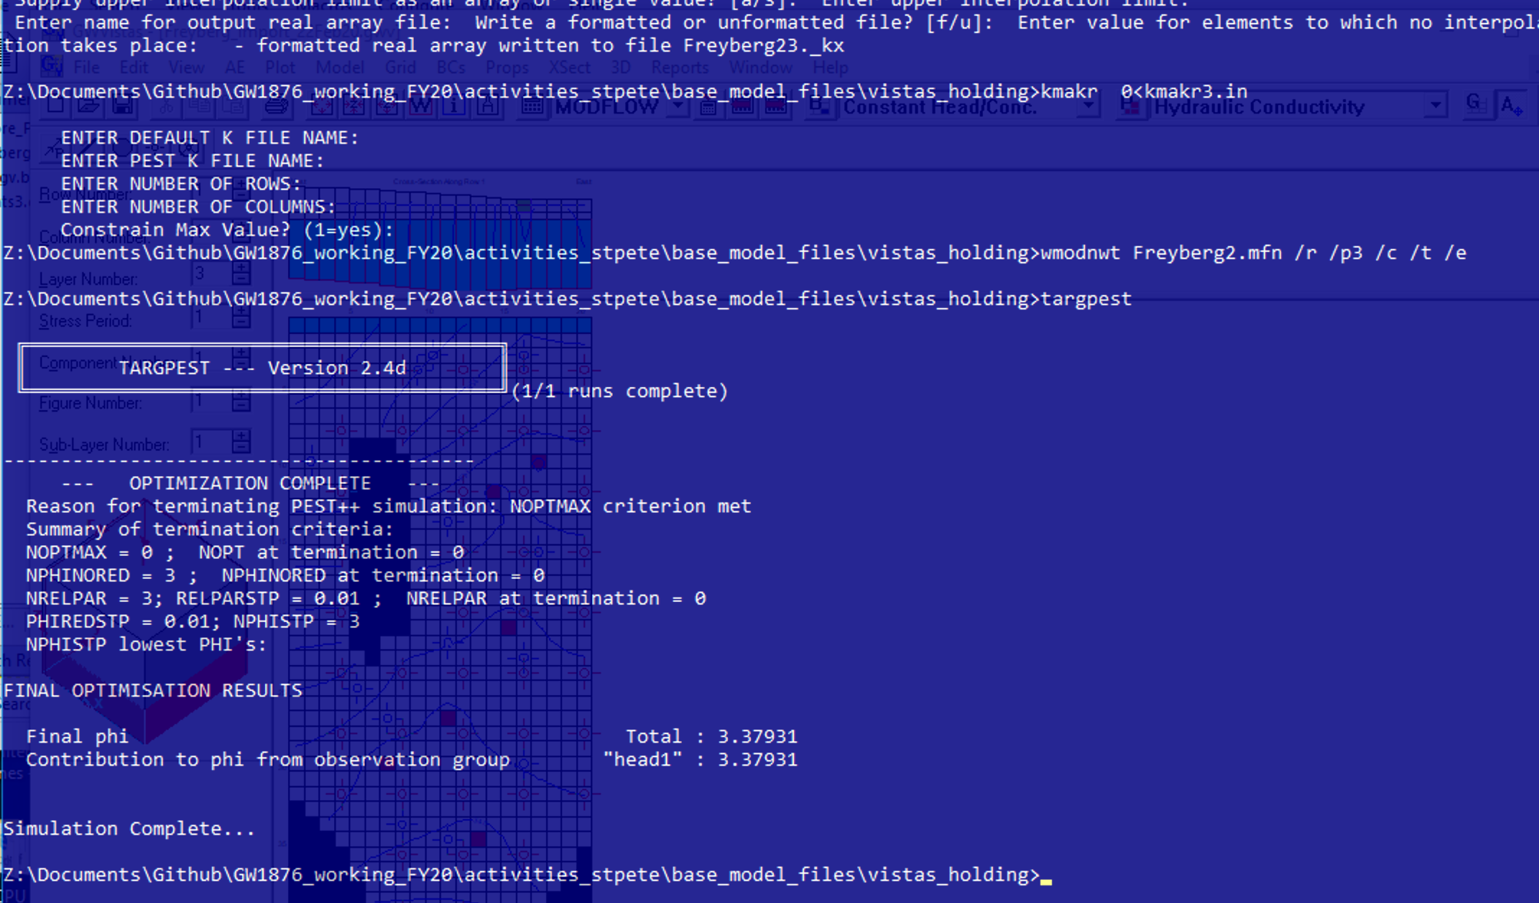
10) Run PESTCHEK.exe
11) Run PESTPP on the Freyberg2.pst file – note same phi as before for initial values

Slide 11
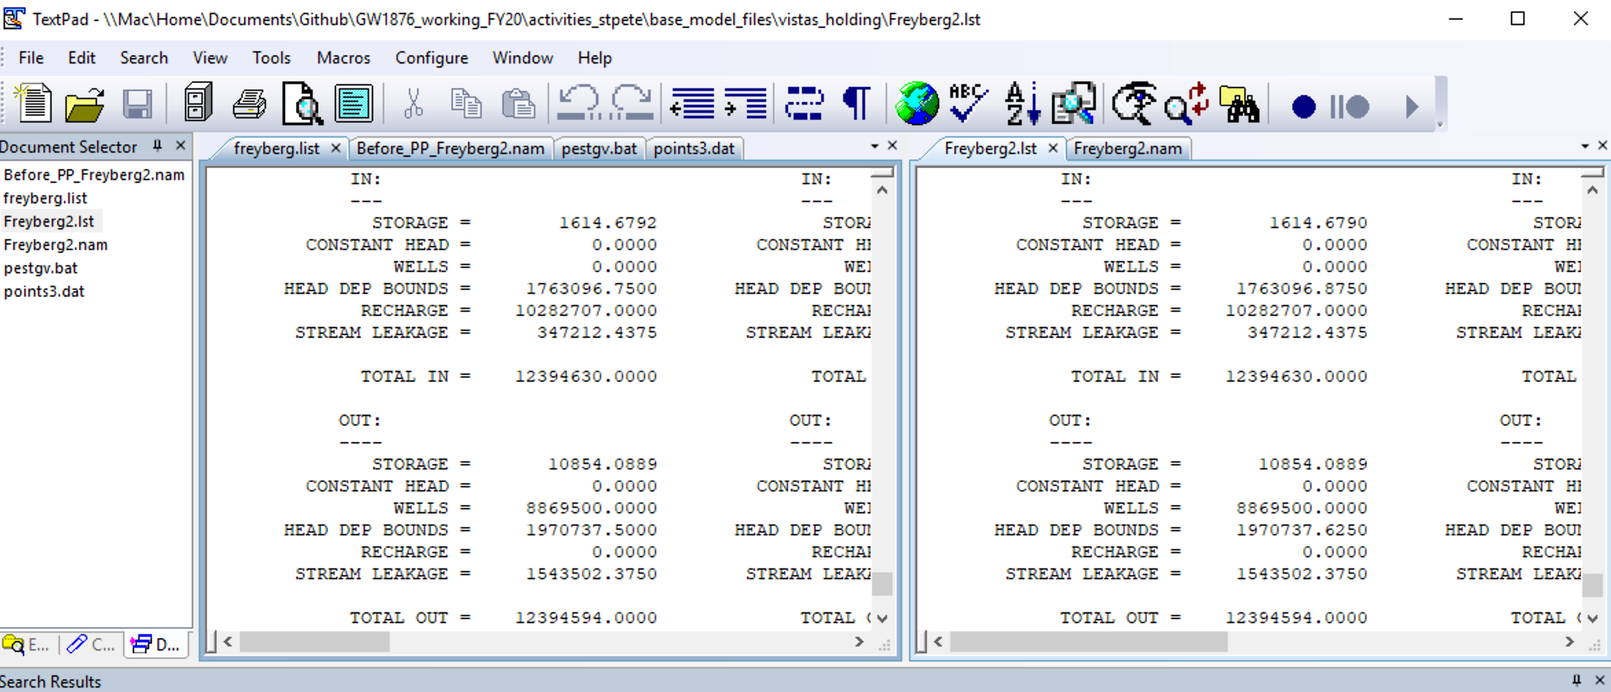
12) Check the pilot point plumbing by comparing MODFLOW LIST file output (cumulative volumetric budget is most stringent) in a text editor. Can also import results and check calibration statistics.
Original .list file from Flopy
New .lst file from PEST PP run

Slide 12
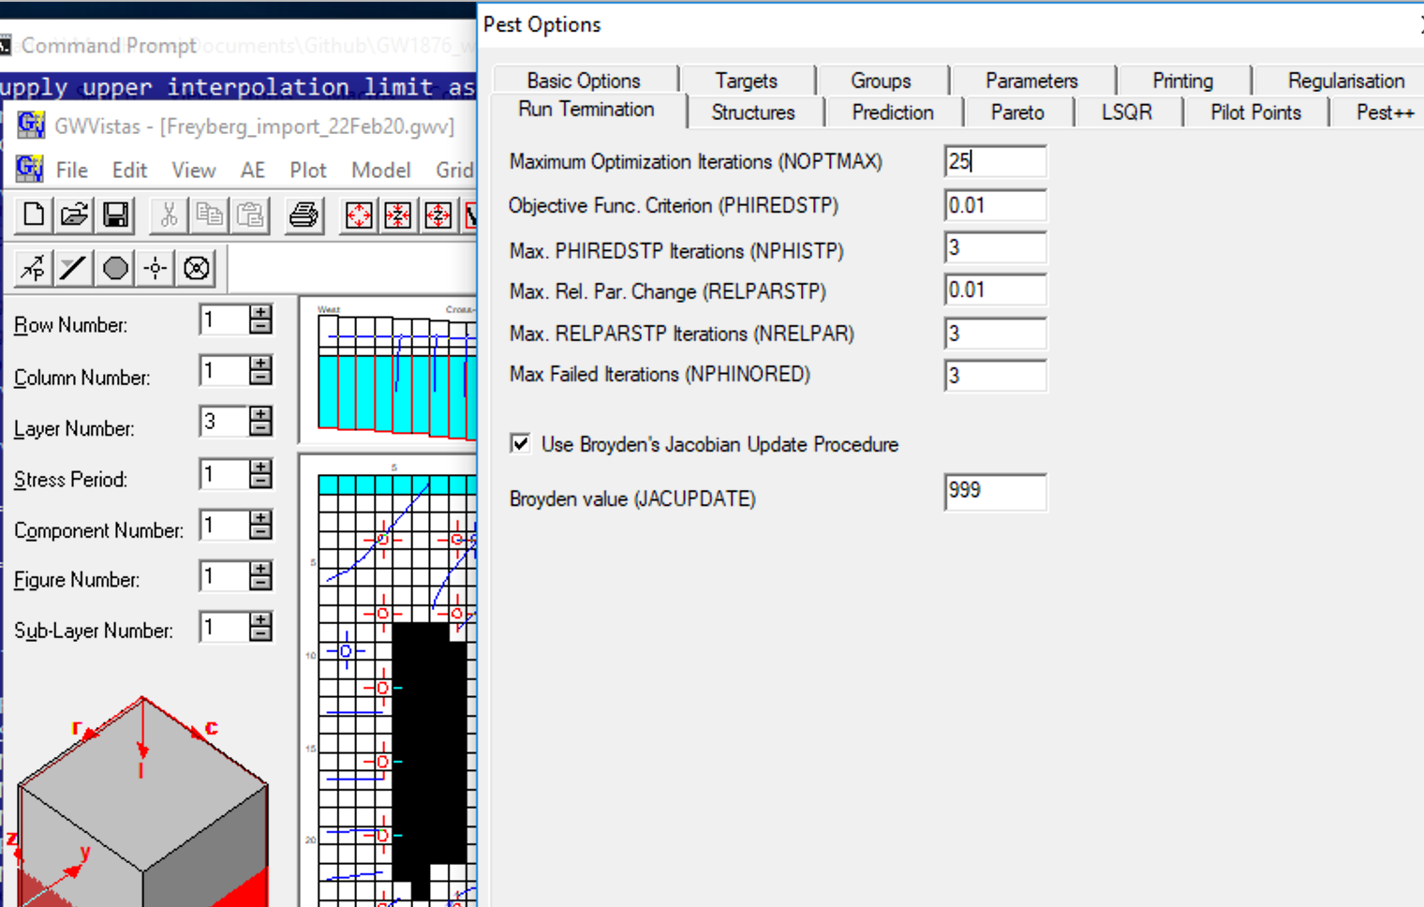
Like Step 13) Change NOPTMAX to 25 to do a parameter estimation run,
(Model->PEST->Options->Run Termination)
redo PESTCHEK.exe, and run pestpp – will take >10 minutes because many more parameters
How much lower was phi? How much better were the unweighted calibration statistics?

